Slide 1
“Always code as if the guy who ends up maintaining your code will be a violent psychopath who knows where you live.”
Rick Osborne

Slide 2
Code Reviews
Manuel Huber

Slide 3

Peer Reviews
Your
a failure
*You’re

Slide 4


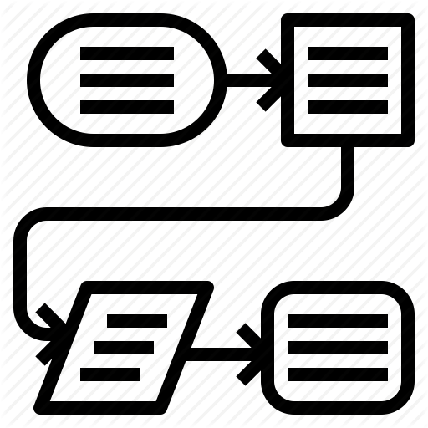

win hearts & minds
set goals
define process
do it

Slide 5
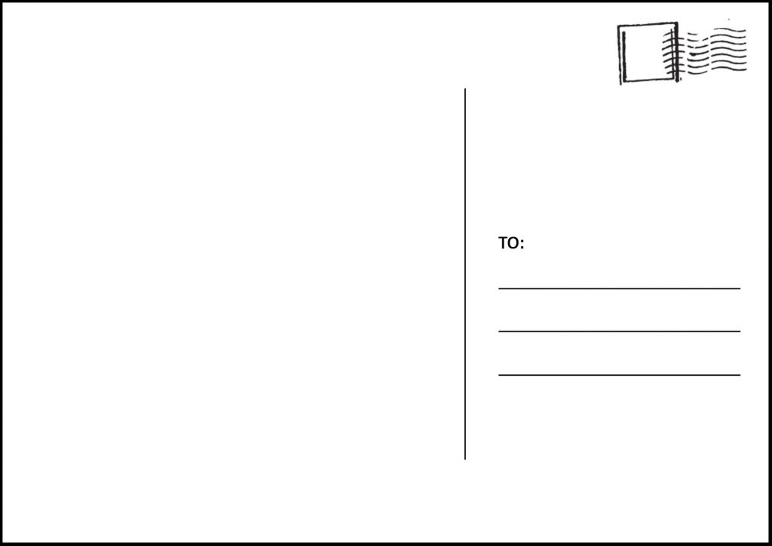

R.I.P
Software Inc.
Hochschulstraße 1
83024 Rosenheim
Greetings from Asia!
Love Dani ♥

Slide 6


Your fault!

Slide 7
Benefits for developers
Shared Ownership & responsibility
Improved code quality → less refactoring
Less bugs → less fixing
Knowledge transfer
Motivates to write better code

Slide 8
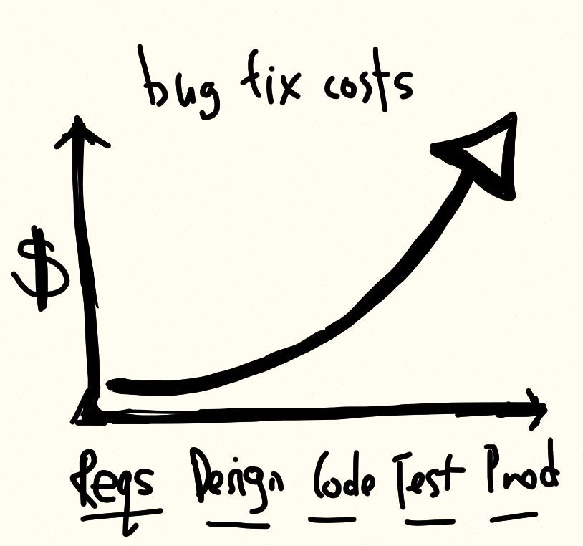

Slide 9
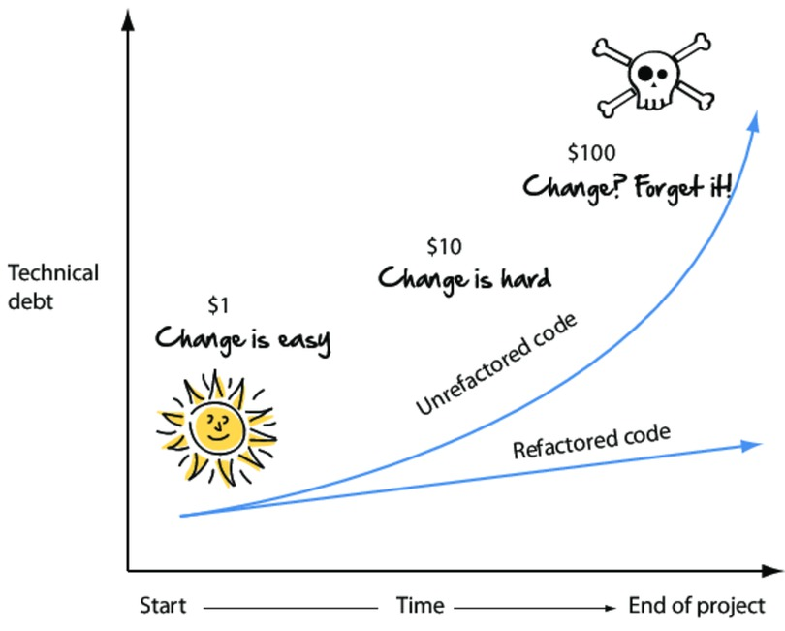

Slide 10
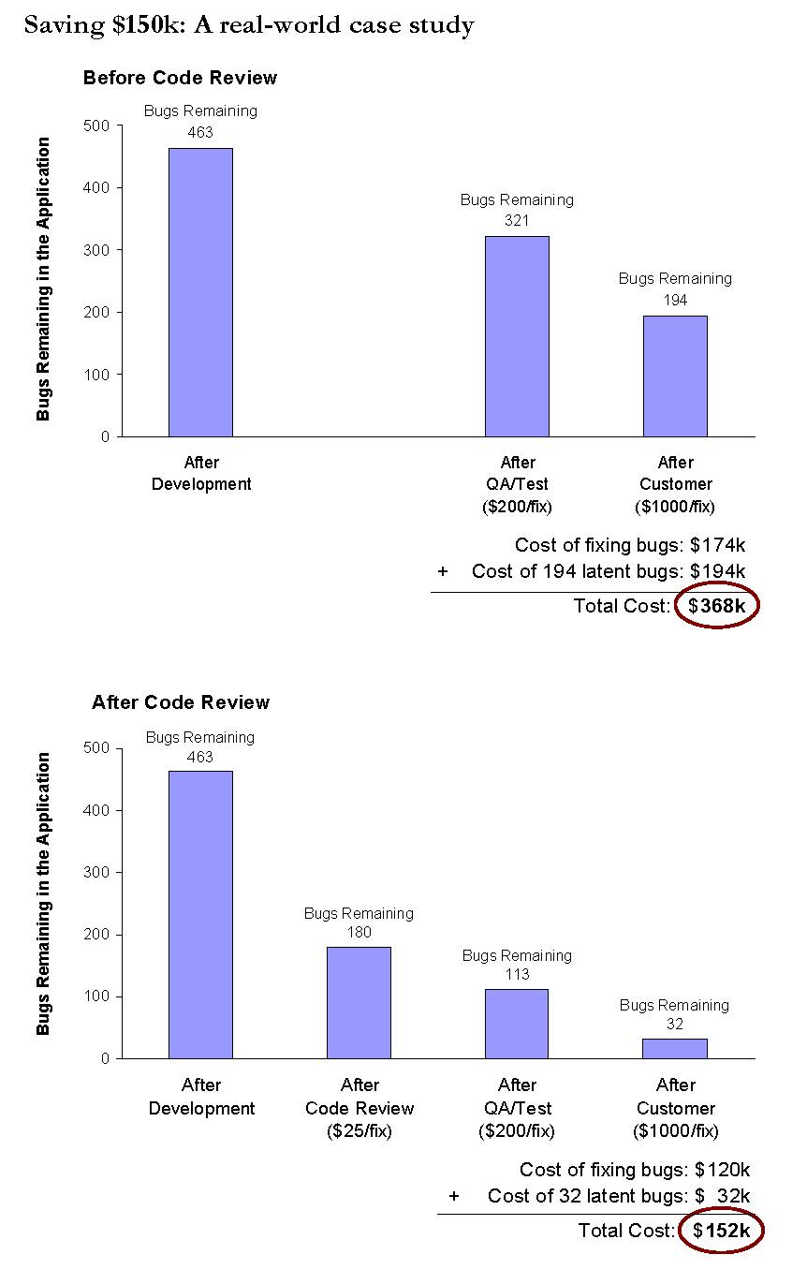
Case study: 10k loc – 10 devs
Without code reviews
With code reviews
Source: “The Best Kept Secrets of Peer Code Review” by Jason Cohen, Steven Teleki & Eric Brown

Slide 11
Benefits for managers / customers
Improved code quality → Cheaper to maintain / expand
Less bugs → Faster & cheaper releases
Reduces “bus factor”
Makes onboarding developers easier
Improved transparency about project

Slide 12
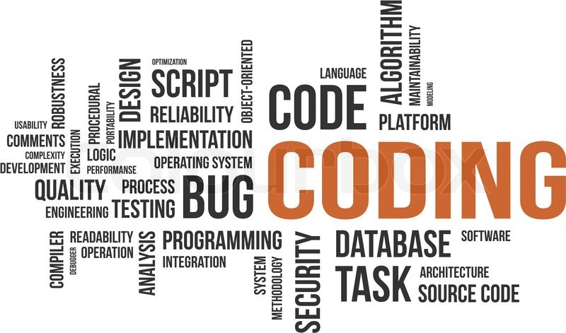
Set goals and frameworks

Slide 13

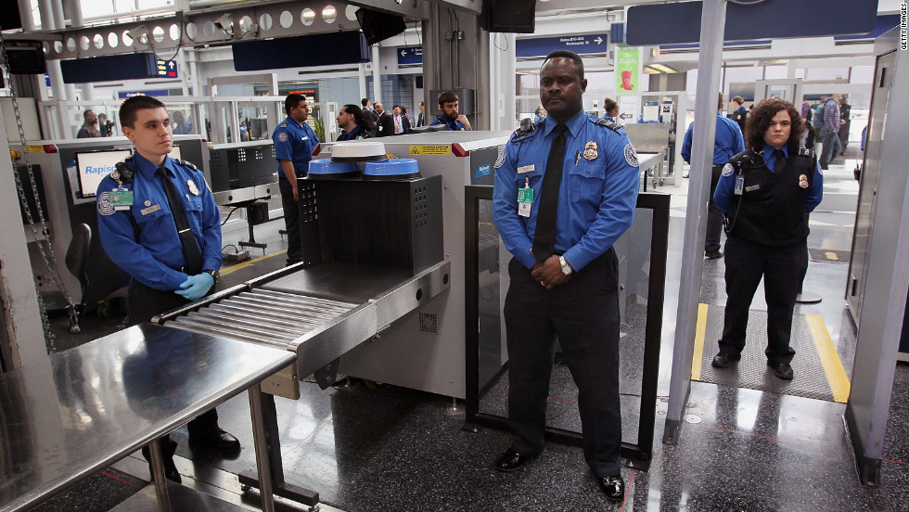

When & What to review?
REVIEW
Dani’s terrible payment service
Review

Slide 14
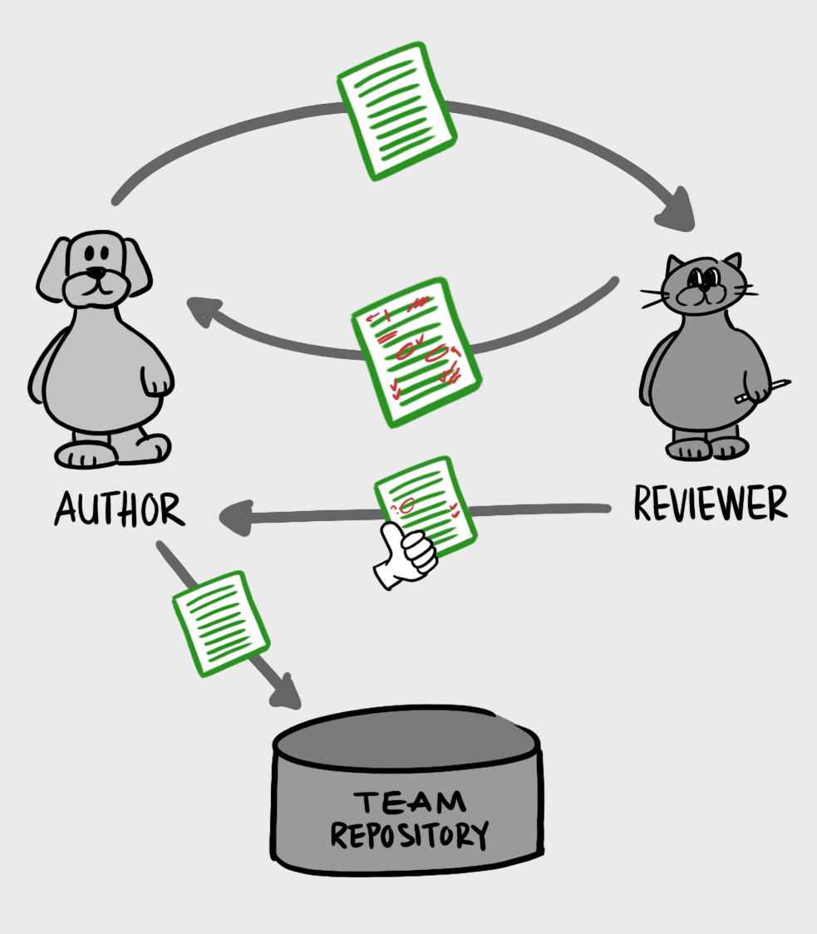


How to review

Slide 15
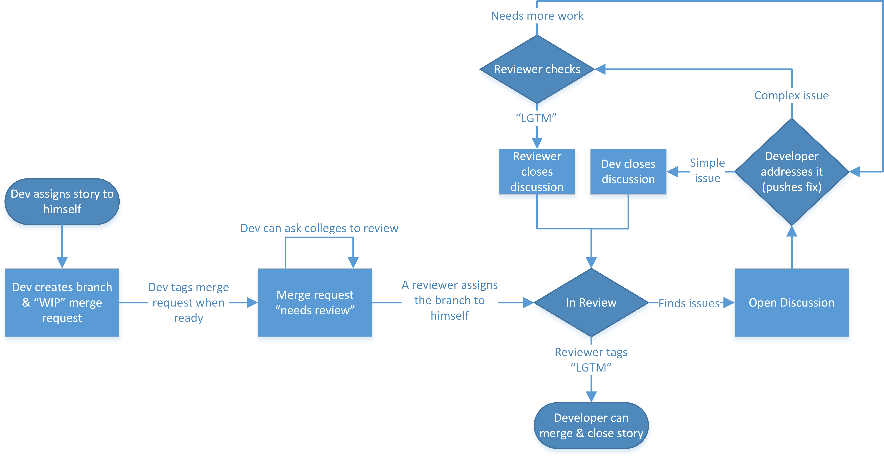

Slide 16
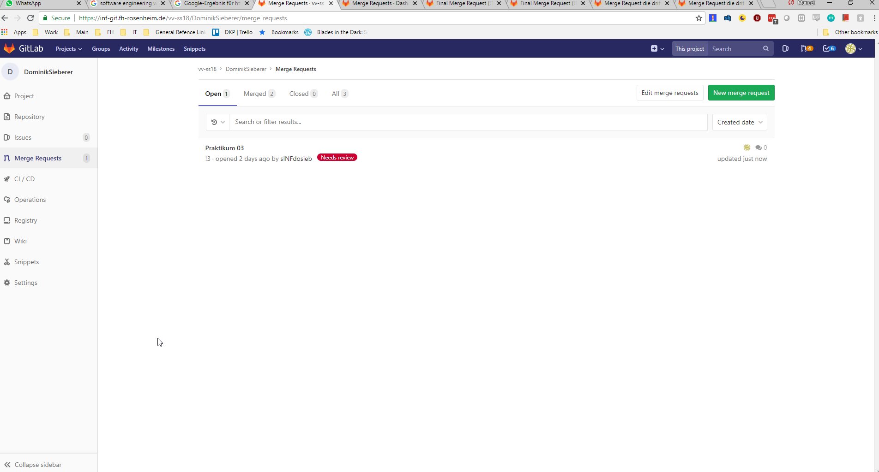

Slide 17
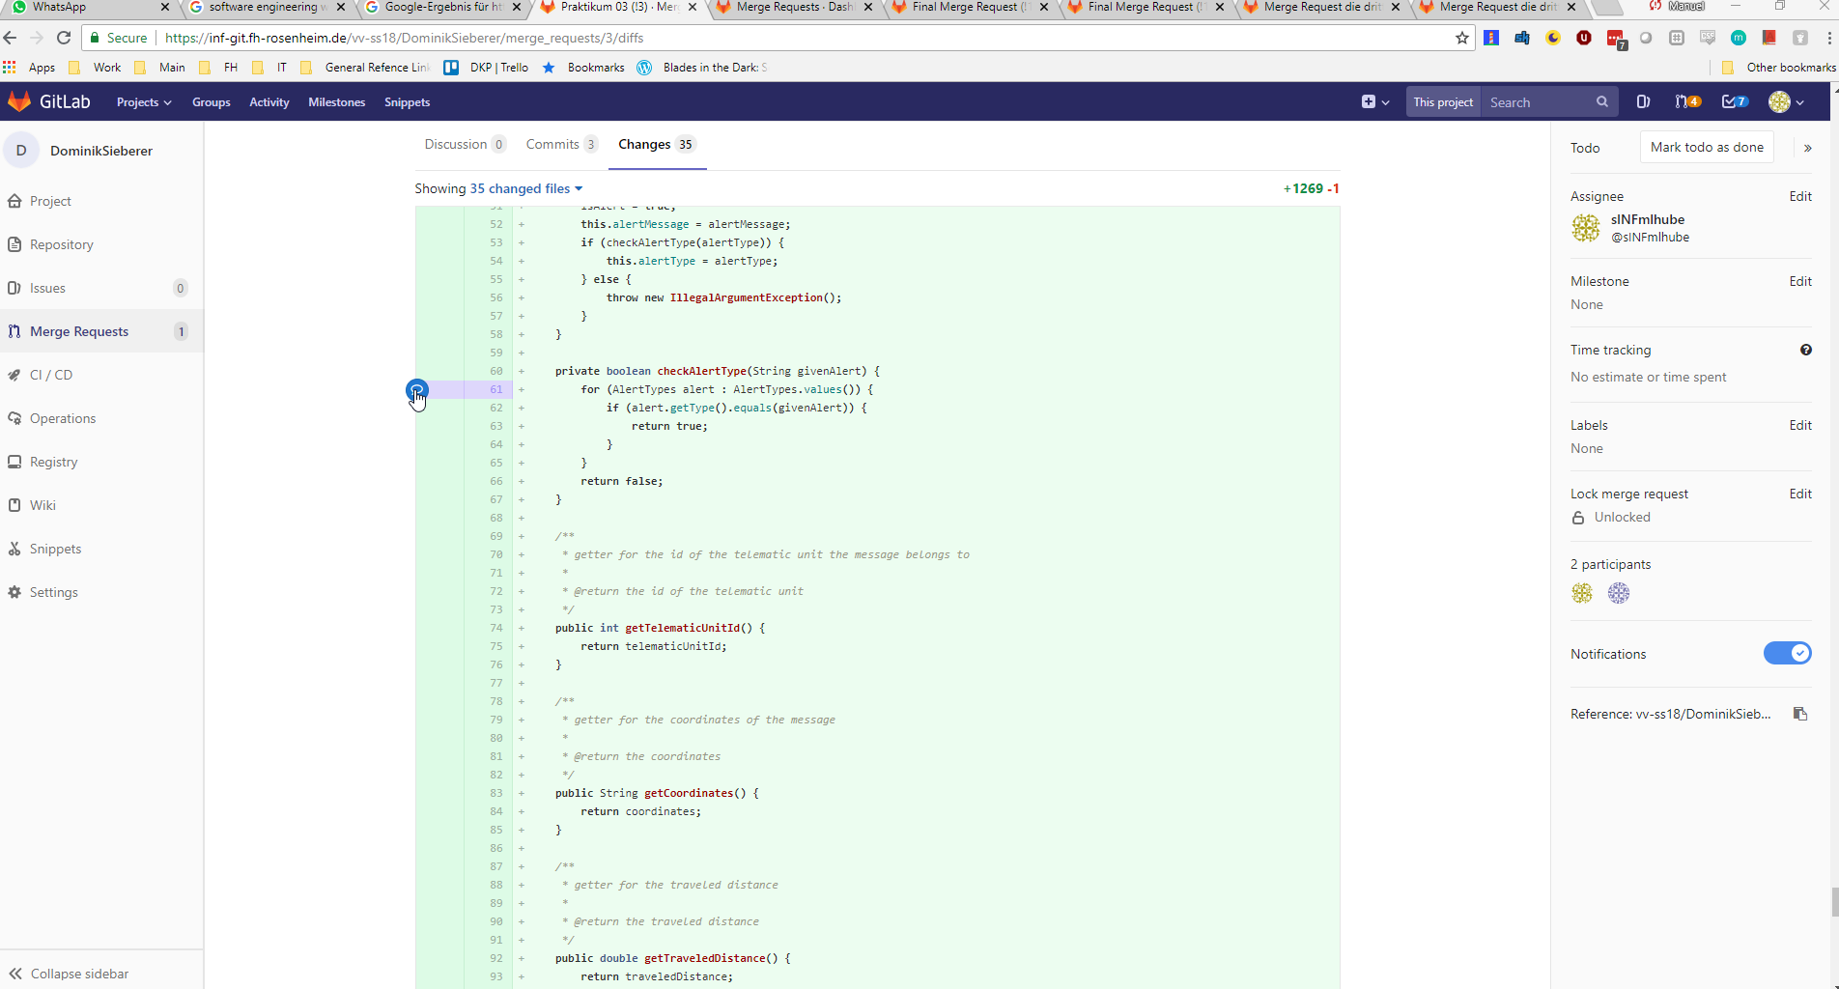

Slide 18
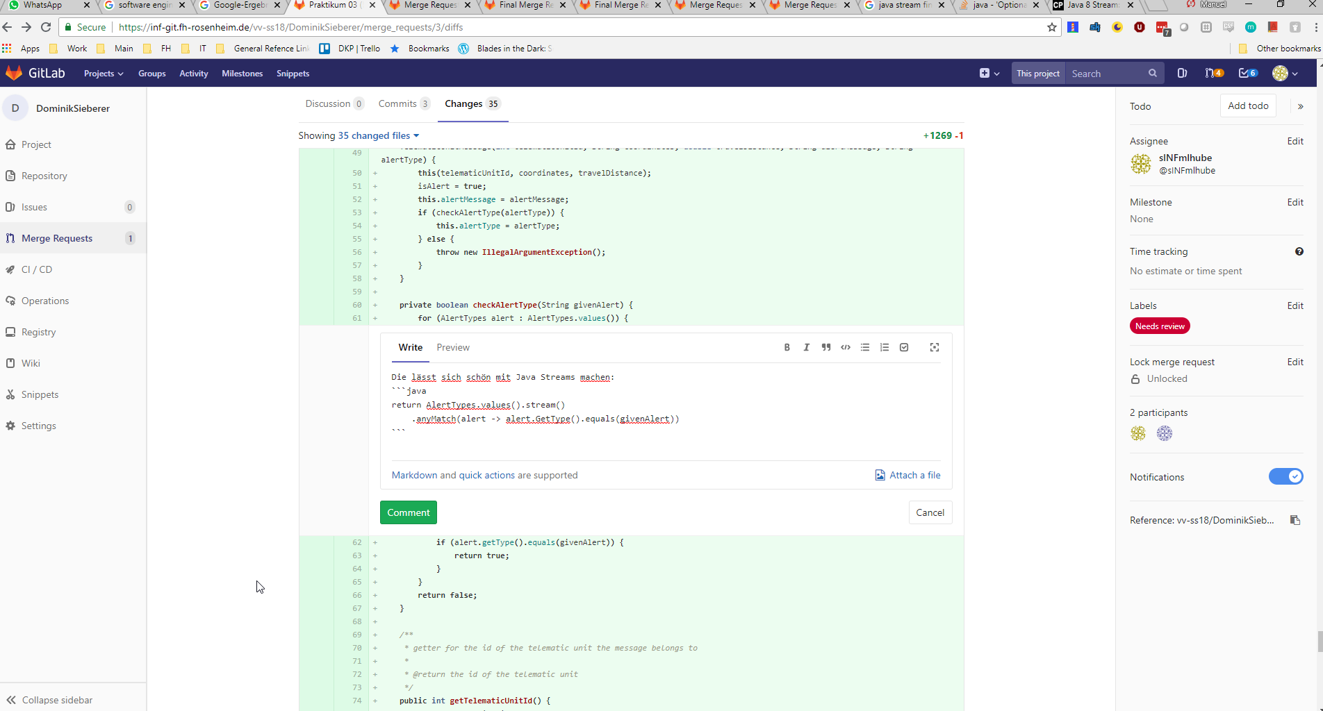

Slide 19
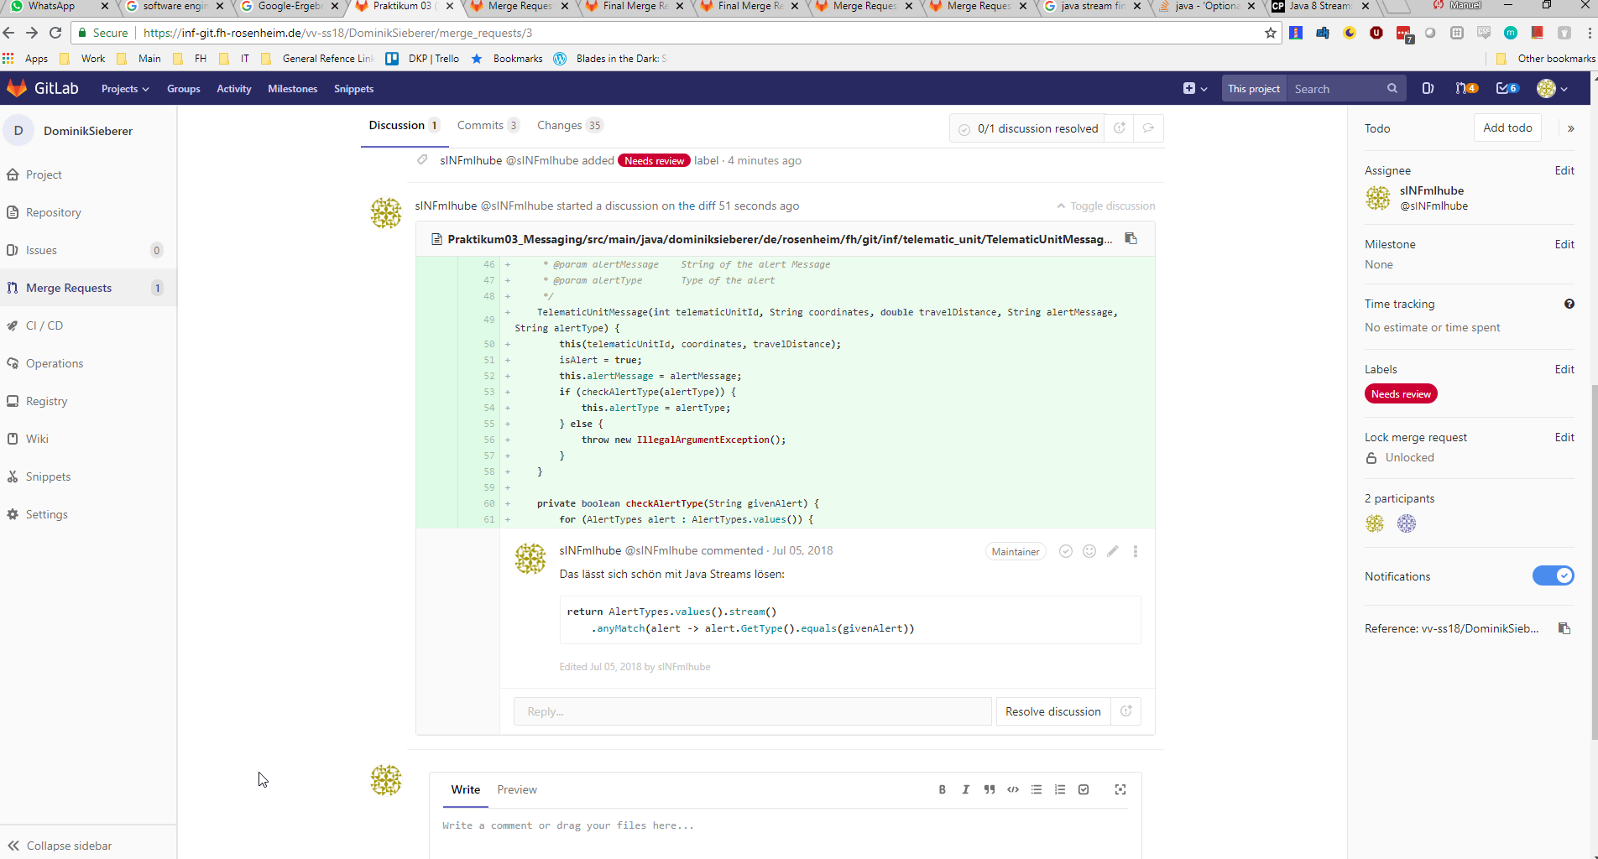

Slide 20
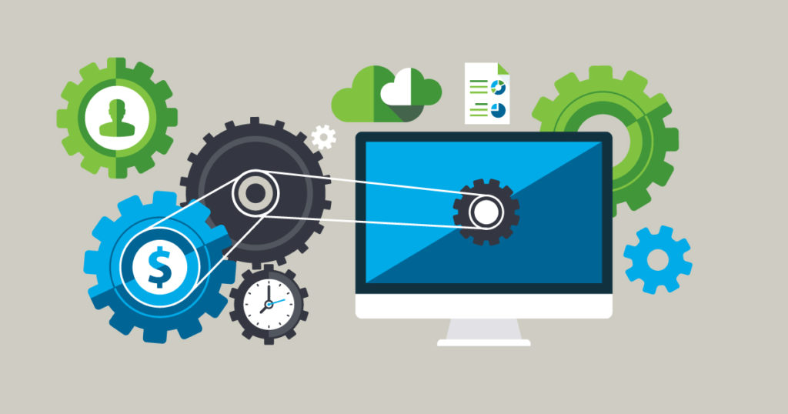

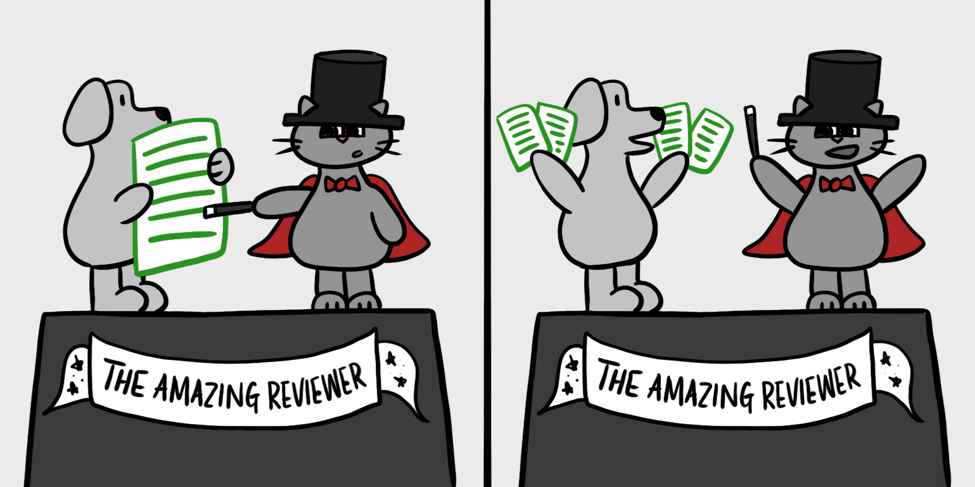

Best Practices

Slide 21
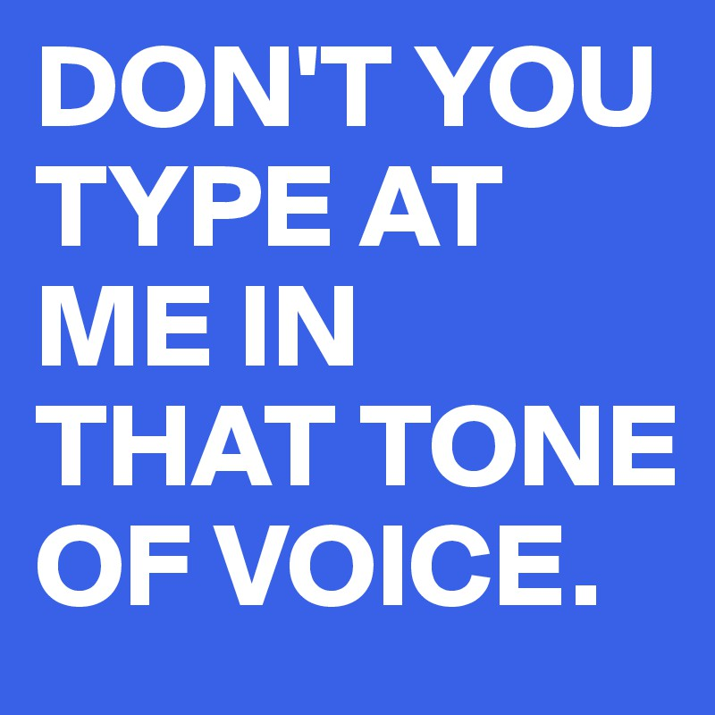
Common Pitfall - Making it personal

Slide 22
bad exmaple
good example
“Du hast dich vertippt”
“Du solltest das auslagern”
“Gib der Variable einen besseren Namen”
“Der Code ist unleserlich”
“Fobar → Foobar”
“Können wir das auslagern?”
“Der Name sollte sprechender sein“
“Ich verstehe den Code nicht“

Slide 23
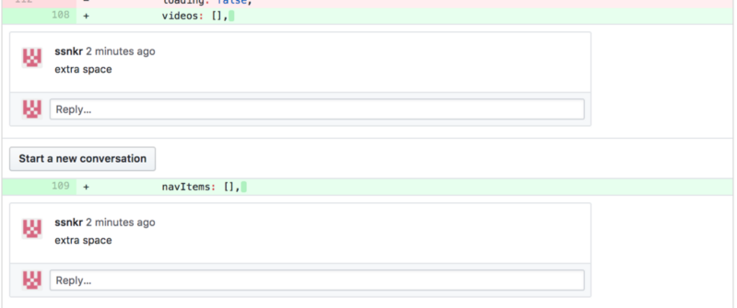
Common Pitfall - Flooding

Slide 24
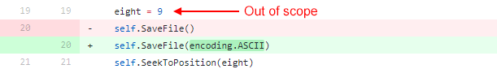
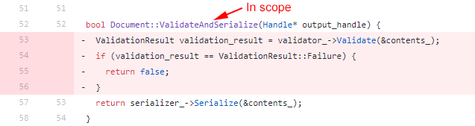
Common Pitfall - “While you’re at it”

Slide 25
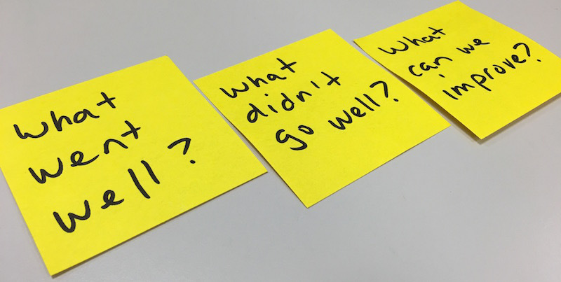
Do a Retrospective

Slide 26


